Slide 1
Oplevering Sprint 4
Nick van der Meer

Slide 2
Inhoudsopgave
Sprint achievements
Demo
Planning

Slide 3
Sprint achievements
Kubernetes in online omgeving
Read/write databases split
load TEsting
GDPR Functionaliteit
Function as a service

Slide 4
Online Kubernetes cluster
AKS
Video bewijs met werkende online cluster

Slide 5
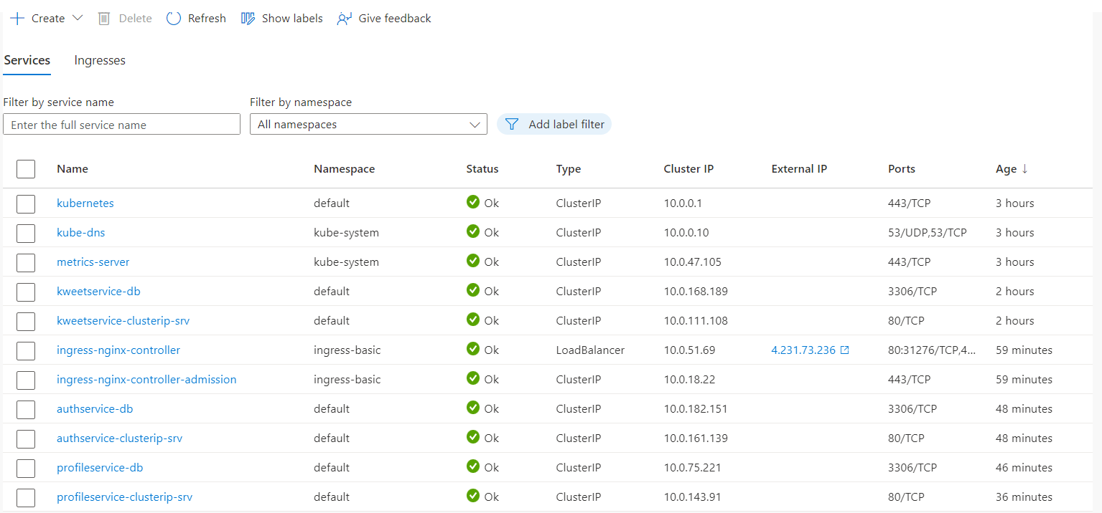
Online Kubernetes cluster

Slide 6
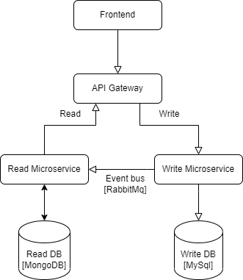
Read/write microservices split
Kweet context
Gesplit in read en write microservice
Verbonden met elkaar via event bus (rabbitmq)
Rollback functionaliteit

Slide 7
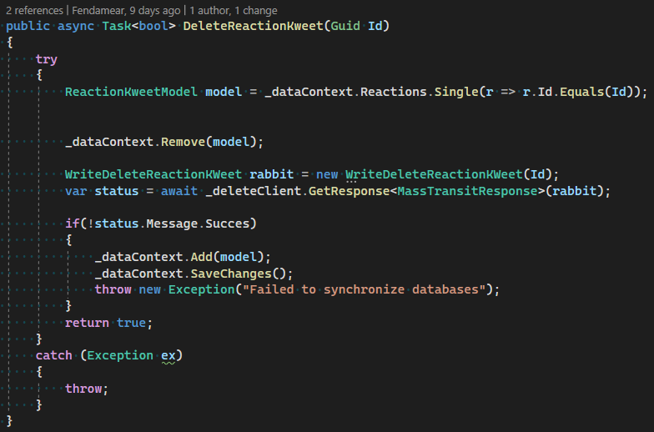
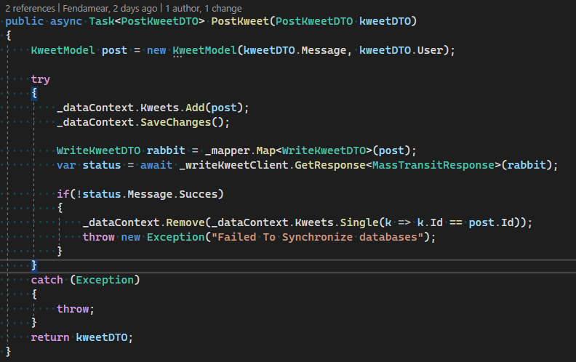
Read/write microservices split

Slide 8
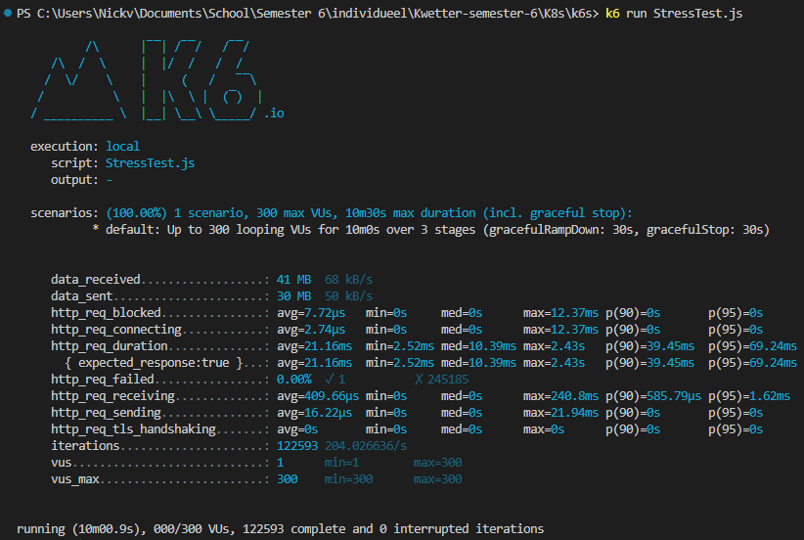
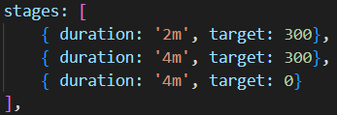
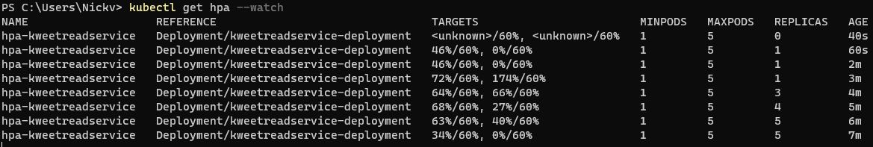
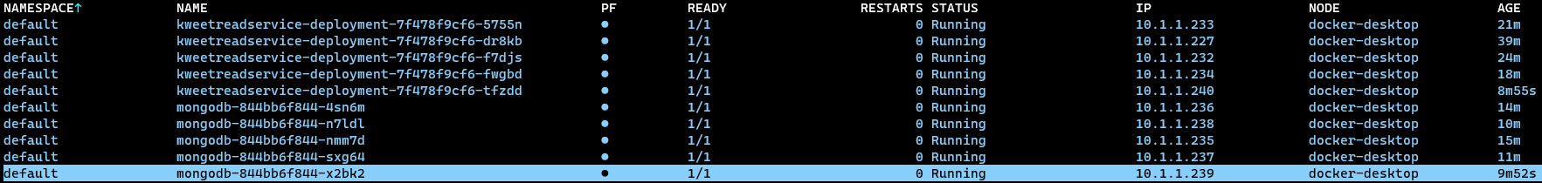
Load Testing

Slide 9
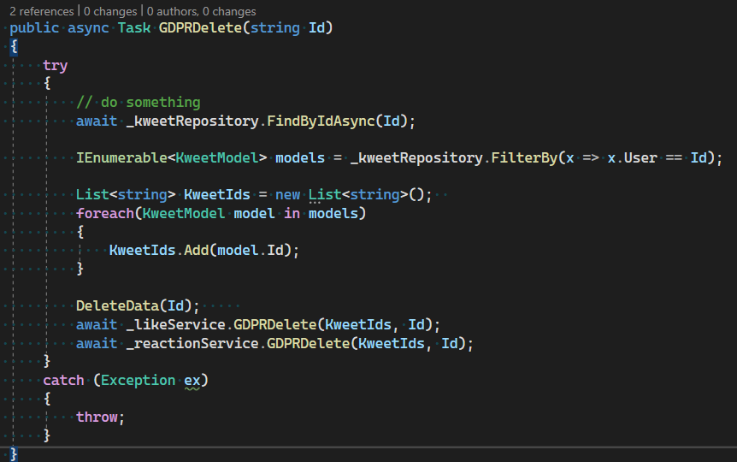
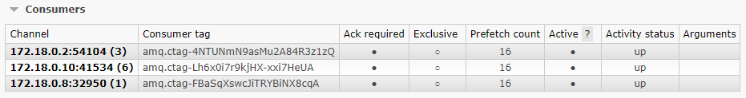
GDPR Delete

Slide 10
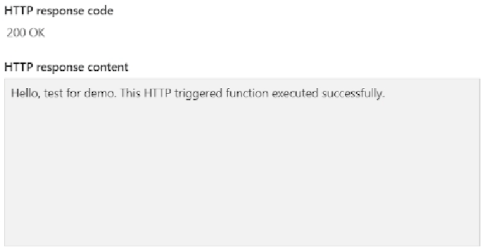
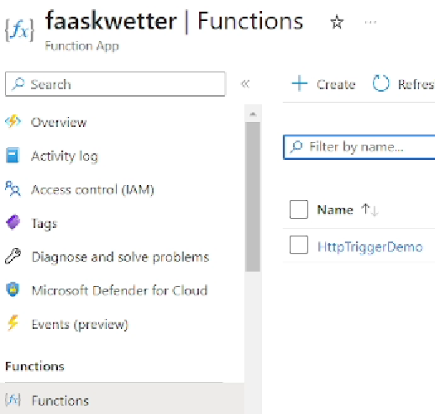
Function as a service

Slide 11
Planning
Sprint 5
Monitoring
Onderzoek

